Slide 1
Converting ER Diagrams to Relational Model
The Basics!

Slide 2
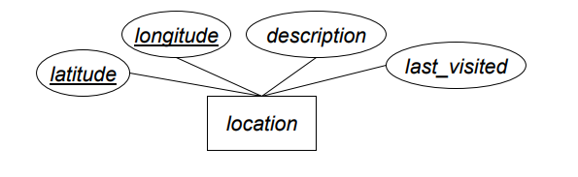
Strong Entities
Create a relational schema with same name E, and same attributes a₁, a₂, …, a_{n}
Same key from ER -> Relational Schema
Ex.
location (latitude, longitude, description, last_visited )

Slide 3
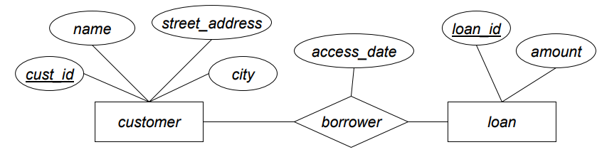
Strong Entities
Create a relational schema with same name E, and same attributes a₁, a₂, …, a_{n}
Same key from ER -> Relational Schema
Ex.
customer(cust_id, name, street_address, city )
loan (loan_id, amount )

Slide 4
Relationships
Binary relationships: depends on the cardinality
If many to many: union of participating entity’s key becomes the primary key of the relation
If one to one: either key is acceptable to be the primary key
If many to one or one to many: key of the “many” side is primary key for the resulting relation

Slide 5
Relationships
Binary relationships: depends on the cardinality
If many to many: borrower(cust_id, loan_id, access_date )

Slide 6
Relationships
Binary relationships: depends on the cardinality
If many to many: borrower(cust_id, loan_id, access_date)
If one to many: borrower (cust_id, loan_id, access_date)
If many to one: borrower (cust_id, loan_id, access_date)

Slide 7
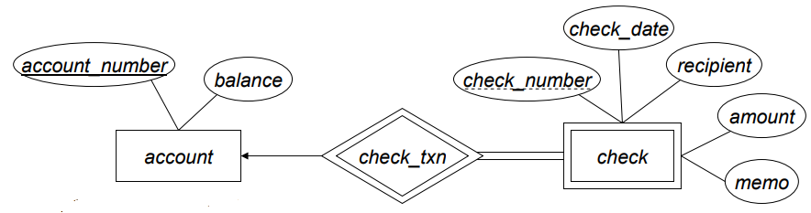
Weak Entities
Weak entities: depends on at least one strong entity
Assuming Entity A owned by Entity B: A has a foreign key identifying entities in B.
account (account_number, balance)
check (account_number, check_number, check_date, recipient, amount, memo )

Slide 8
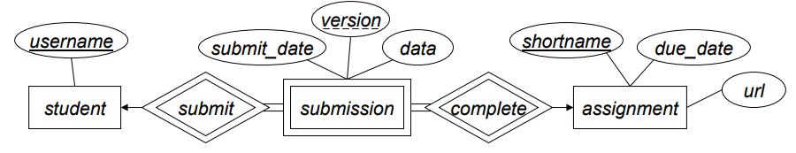
Weak Entities
Weak entities: depends on at least one strong entity
student (username)
assignment (shortname, due_date, url)
submission (username, shortname, version, submit_date, data)

Slide 9
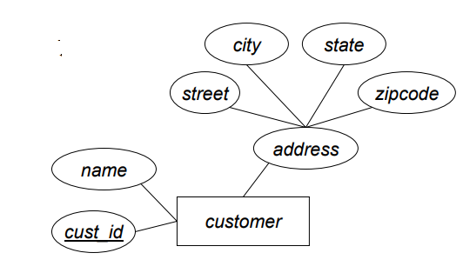
Composite attributes
Each ER entity’s attribute maps to a separate attribute in relational schema
customer(cust_id, name, street, city, state, zipcode)

Slide 10
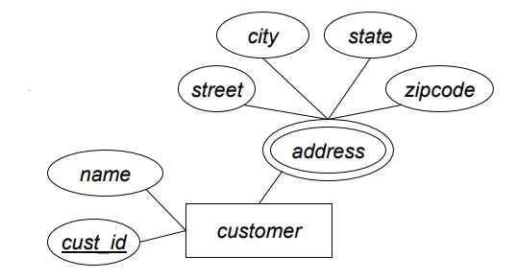
Multivalued attributes
Multivalued attributes require a separate relational schema
customer(cust_id, name)
cust_addrs (cust_id, street, city, state, zipcode)

